Slide 1
Latest Trends in Identity Theft
Niloufer Tamboly, CISSP, CPA, CFE, CGMA, CIA, CISA

Slide 2
90% of What We Worry
About
Never Happens

Slide 3
Today let’s talk about the 10%

Slide 4
Identity Theft - A Gateway Crime
What is identity theft?
Fraudulent acquisition or use of a person’s personally identifiable information (PII)
What is identity fraud?
When the information acquired fraudulently is used for illicit gain

Slide 5
Identity theft complaints in the U.S. in 2017, by nature of crime
Identity theft complaints in the U.S. 2017, by nature of crime
Note: United States; 2017
Further information regarding this statistic can be found on page 8.
Source(s): Federal Trade Commission; ID 194017
2

Slide 6
2018 Identity Fraud Trends
6.64% of consumers became victims of identity fraud
Account takeover grew significantly to $5.1 Billion, a four year high
Online shopping present the greatest fraud risk
Card not present 81% more prevalent than point of sale fraud
Fraudsters are causing 200% more monetary damage than previous high
© 2018 Javelin Strategy & Research, Identity Fraud Study

Slide 7
2018 Identity Fraud Trends
So what are you going to see more off?
Account Takeover
New Accounts
Card Not Present
© 2018 Javelin Strategy & Research, Identity Fraud Study

Slide 8
Share of internet users in the United States who have been victim of online identity theft as of October 2018
U.S. internet user online identity theft rate 2018
Note: United States; October 2018; 18 years and older; 1,209 Respondents; internet users
Further information regarding this statistic can be found on page 8.
Source(s): YouGov; ID 763130

Slide 9
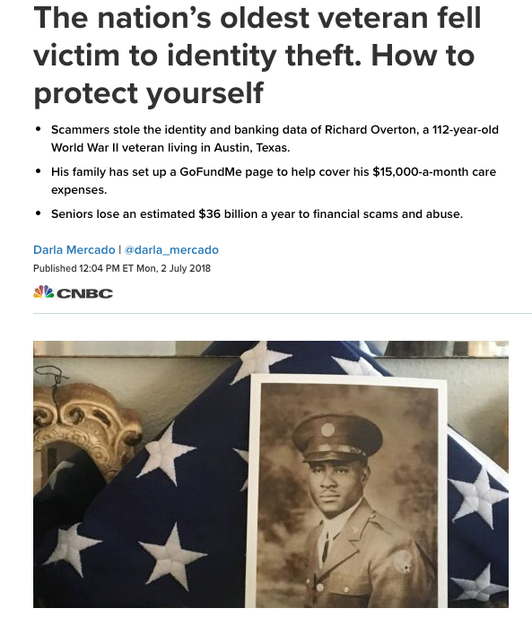
I am over a hundred years old and never click on a link in an email

Slide 10
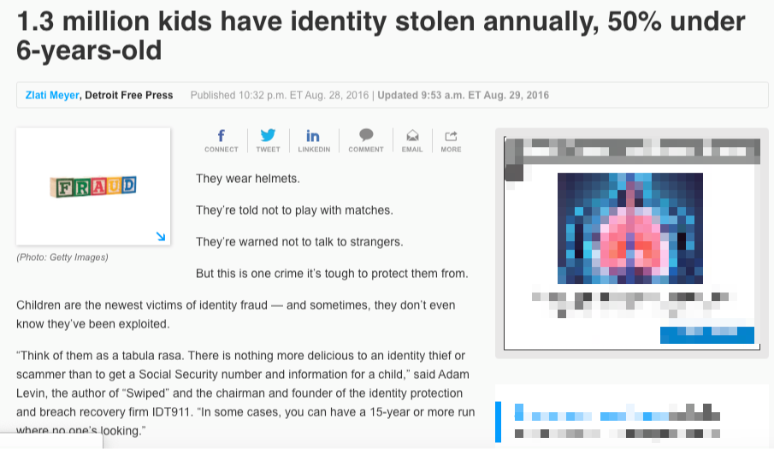
I am 6 years old and have never shopped online

Slide 11
Identity theft complaints lodged with F.T.C. in the U.S., by victims age in 2017
Reported cases of identity theft in the U.S., by victims age, 2017
Note: United States; 2017
Further information regarding this statistic can be found on page 8.
Source(s): Federal Trade Commission; ID 587677
4

Slide 12
Can you prevent identity theft?
No, but you can detect it early

Slide 13
First
Optout of prescreened offers
Place a security freeze on your NCTUE Disclosure Report
Place a credit freeze
TransUnion.com/credit-help
Experian.com/help
Equifax.com/personal/credit-report-services
Check your credit report for free

Slide 14
Then
Review your bank, credit card statements
Read your Statement of Benefits sent by your health insurance carrier
Sign up for ID theft monitoring service

Slide 15
…
Use a password manager
Set up multi factor authentication
Use a VPN service when using public WiFi

Slide 16
…
Don't click links in emails
Sign up for paperless billing
Don’t provide any PII information to a caller over the phone

Slide 17
…
Keep your computer software updated, install anti-virus and firewall
Shred all mail with PII
Contact the post office if you notice any changes in your mail delivery

Slide 18
Now is my identity secure
No!
But by being proactive you can manage the impact

Slide 19
Lifecycle of a stolen identity
How is an identity stolen?

Slide 20
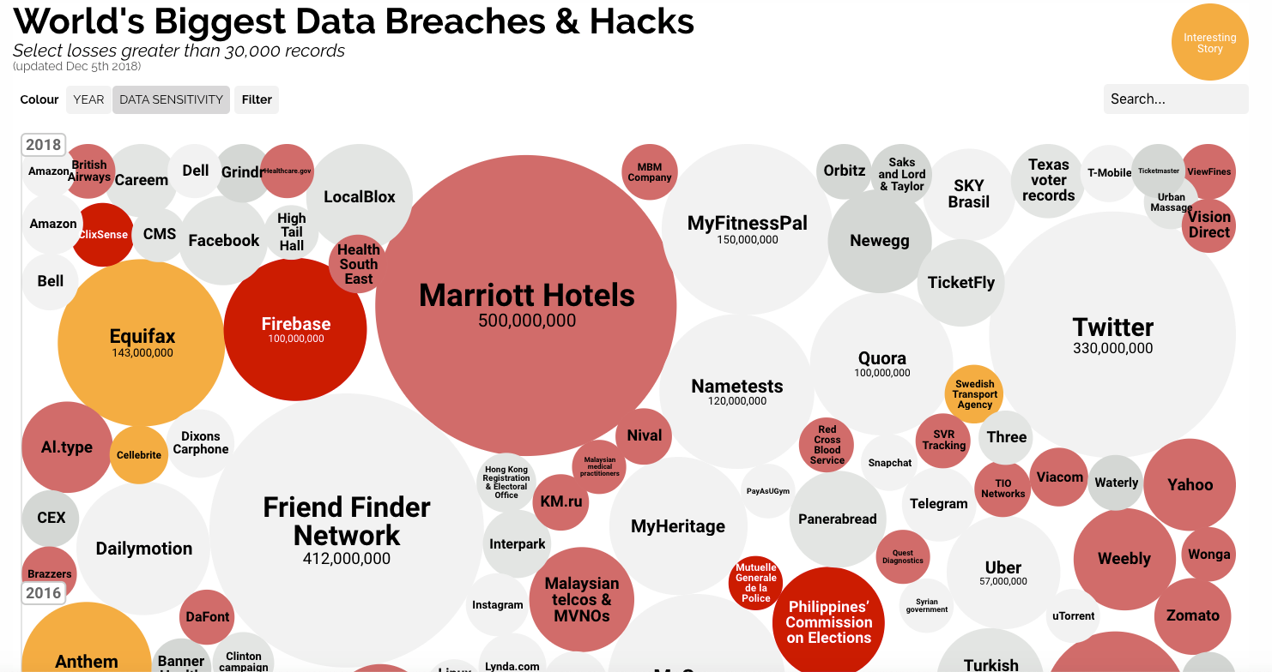
https://informationisbeautiful.net/visualizations/worlds-biggest-data-breaches-hacks/

Slide 21
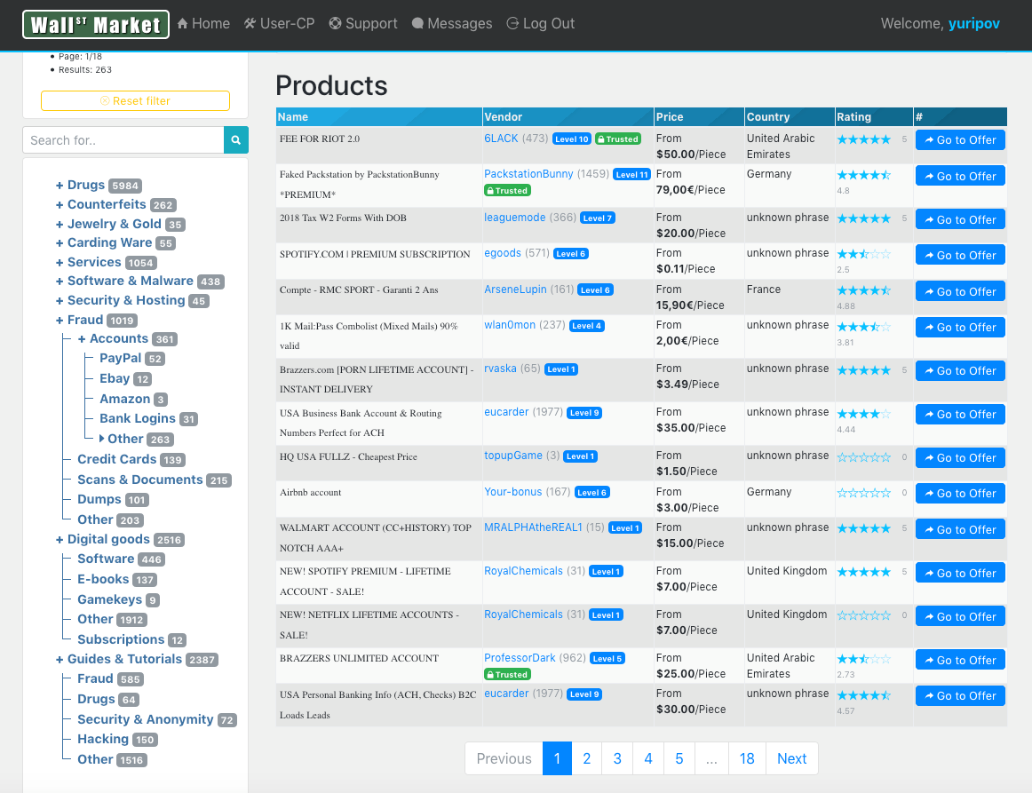
Traded

Slide 22
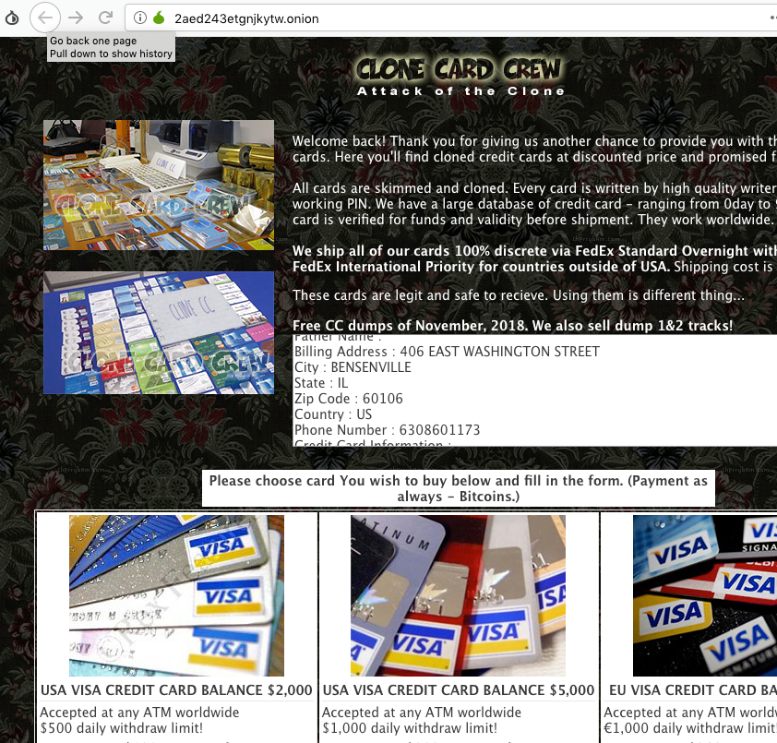
Card shop selling skimmed and cloned cards

Slide 23
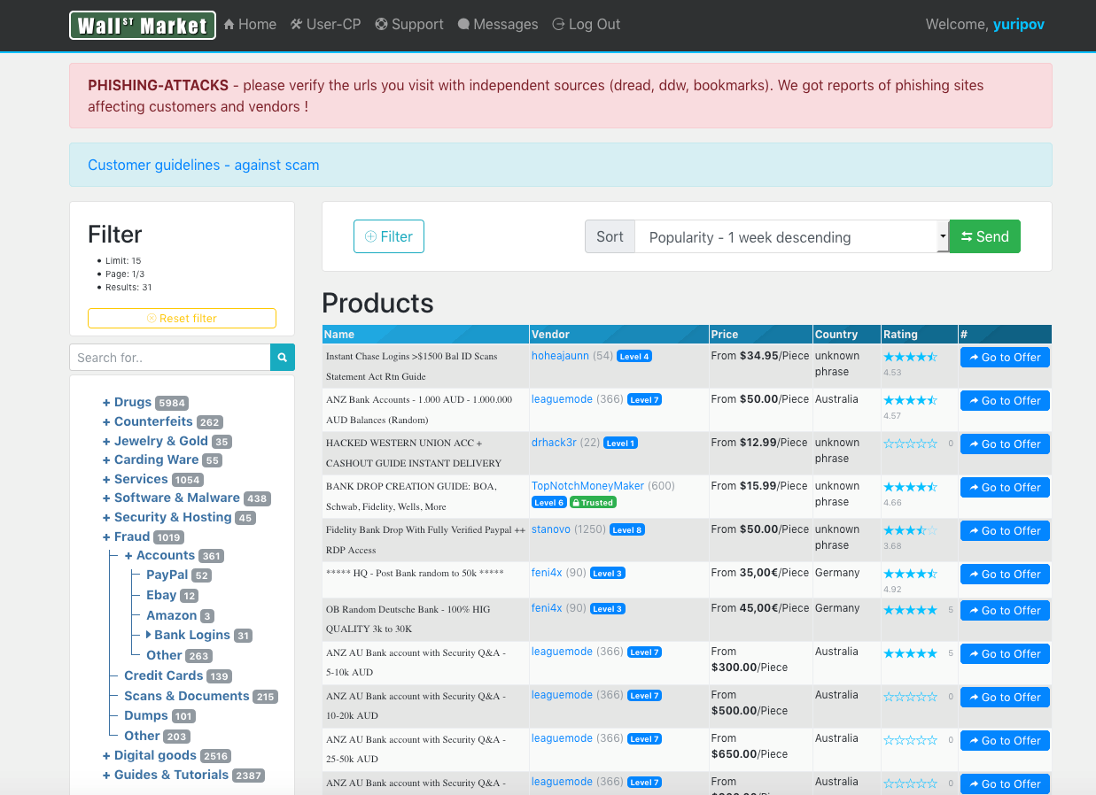
Recycled - Phishing warning on dark web

Slide 24
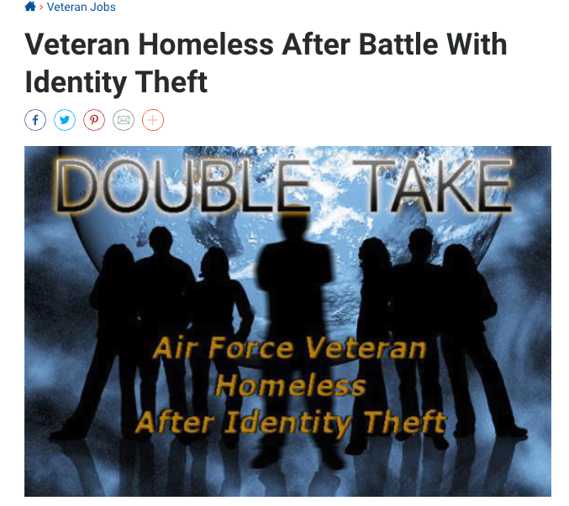
Criminal charges due to stolen identity
https://www.military.com/veteran-jobs/security-clearance-jobs/2013/09/03/veteran-homeless-after-battle-with-identity-theft.html

Slide 25
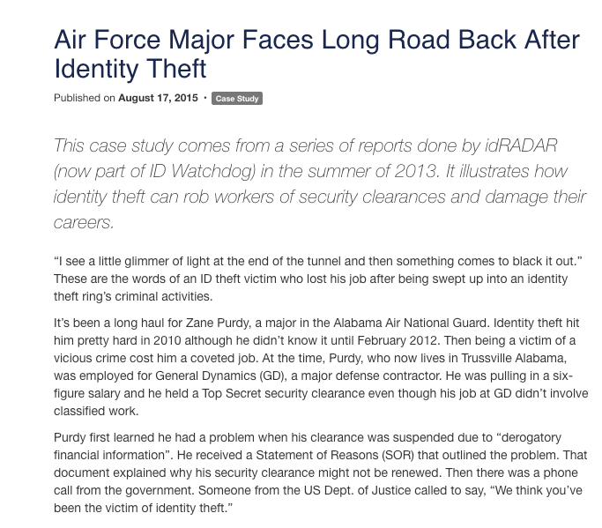
Loss of security clearance due to stolen identity
https://www.military.com/veteran-jobs/security-clearance-jobs/2013/09/17/major-faces-long-road-back-after-identity-theft.html

Slide 26
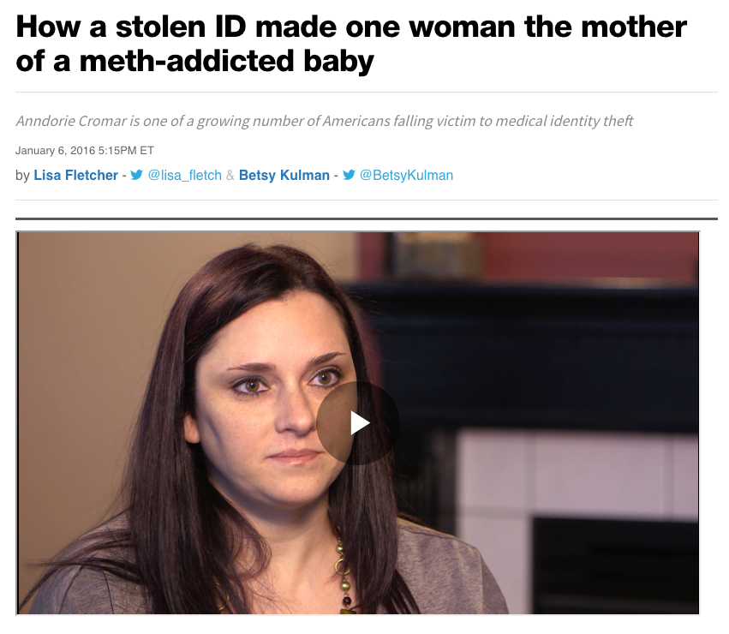
Child protective services at your door due to stolen identity?
http://america.aljazeera.com/watch/shows/america-tonight/articles/2016/1/6/how-a-stolen-id-made-one-woman-the-mother-of-a-meth-addicted-baby.html

Slide 27
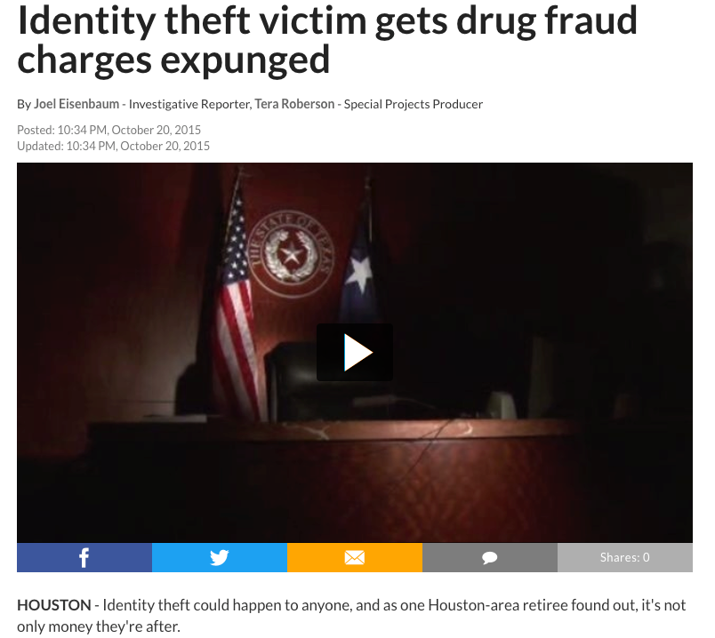
Drug charges due to medical identity theft
https://www.click2houston.com/news/investigates/identity-theft-victim-gets-drug-fraud-charges-expunged

Slide 28
Victim enabled identity theft
A victim is deceived into providing their personally identifying information (PII) to a fraudster
Fraudster calls the victim using psychological triggers:
Like free offer, FOMO, credit applied to account
Or with offer to share the proceeds of fraud
47% Medical identity fraud cases occur when people knowingly share their information
Source: https://www.consumerreports.org/medical-identity-theft/medical-identity-theft/

Slide 29
Recovery
Call the companies where you know fraud occurred
Place a fraud alert on your credit file
Go to https://www.identitytheft.gov/Assistant

Slide 30
…
Create an identity theft report on the FTC website
Create an account and recovery plan
File a police report

Slide 31
Obtain & Review Reports
Your Credit Reports
Record of all Phone, Pay TV and Utility NCTUE report
Obtain copy of your ChexSystems report

Slide 32
...
Check your Social Security Account
Driver history abstract – from DMV
Obtain Criminal History Report from State Police

Slide 33
Cleanup
Send the police report to all the credit agencies and place fraud alert
Close accounts opened in your name
Remove charges from your account

Slide 34
…
Correct credit report - “Account Closed at Consumer’s Request.”
File form 14039 Identity Theft Affidavit with IRS
Sign up for ID theft monitoring service

Slide 35
A few more things…
Social Security Administration – report misuse
Reply to any debt collection notice within 30 days
Report identity theft to your motor vehicle department

Slide 36
and…
Report identity theft to US Department of State (whether you have a passport or not)
Contact Telecheck and Certegy if someone is writing bad checks
Student loans– provide identity theft report to close the loan
Apartment Rentals – Get your tenant history report corrected
Bankruptcy – Contact US Trustee https://www.justice.gov/ust

Slide 37
Questions

Slide 38
Niloufer Tamboly, Co-founder & President, (ISC)² New Jersey Chapter (a membership based association of cybersecurity professionals) Niloufer ( ntamboly@gmail.com )is a risk management professional and helps companies prevent, detect and mitigate technology and business risks. United States Patent Office has granted her two patents for “System For And Method of Generating Visual Passwords” (US 9,171,143 B2) and “Establishing An Alternate Call Path Using Short-Range Wireless Technology” (US 9,392,523).

